Slide 1


<Name>
<Date>

Slide 2

Outline
Executive Summary
Introduction
Methodology
Results
Conclusion
Appendix

Slide 3
Executive Summary
Summary of methodologies
Summary of all results

Slide 4
Introduction
Project background and context
Problems you want to find answers

Slide 5

Section 1

Slide 6
Methodology
Executive Summary
Data collection methodology:
Describe how data was collected
Perform data wrangling
Describe how data was processed
Perform exploratory data analysis (EDA) using visualization and SQL
Perform interactive visual analytics using Folium and Plotly Dash
Perform predictive analysis using classification models
How to build, tune, evaluate classification models

Slide 7
Data Collection
Collect data from SpaceX API
Clean and format collected JSON data into table

Slide 8
Data Collection - Scraping
BeautifulSoup to do web scraping Falcon 9 historical launch records wiki page https://en.wikipedia.org/wiki/List_of_Falcon_9_and_Falcon_Heavy_launches
Extract required data from Html into our dataframe

Slide 9
Data Wrangling
Analyze different cases where the booster did not land successfully.
Introduce Class column, to label 1 being successfully landed and 0 otherwise.
Github

Slide 10
EDA with Data Visualization
In order to predict Falcon 9 first stage will land successfully or not, we need to carefully analyze and understand the relationships between each columns and features.
Correlation map, scatter plot, bar charts, line graph are best to visualize the relationships.
Github

Slide 11
EDA with SQL
Using bullet point format, summarize the SQL queries you performed
Add the GitHub URL of your completed EDA with SQL notebook, as an external reference and peer-review purpose

Slide 12
Build an Interactive Map with Folium
Summarize what map objects such as markers, circles, lines, etc. you created and added to a folium map
Explain why you added those objects
Add the GitHub URL of your completed interactive map with Folium map, as an external reference and peer-review purpose

Slide 13
Build a Dashboard with Plotly Dash
Summarize what plots/graphs and interactions you have added to a dashboard
Explain why you added those plots and interactions
Add the GitHub URL of your completed Plotly Dash lab, as an external reference and peer-review purpose

Slide 14
Predictive Analysis (Classification)
Summarize how you built, evaluated, improved, and found the best performing classification model
You need present your model development process using key phrases and flowchart
Add the GitHub URL of your completed predictive analysis lab, as an external reference and peer-review purpose

Slide 15
Results
Exploratory data analysis results
Interactive analytics demo in screenshots
Predictive analysis results

Slide 16

Section 2

Slide 17
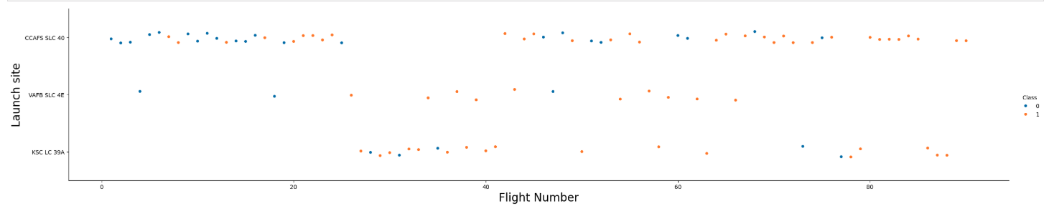
Flight Number vs. Launch Site
Launch site CCAFS SLC 40 has the most flights launched compared to the other two sites. However, VAFB SLC 4E seems to be the site with the most success.

Slide 18
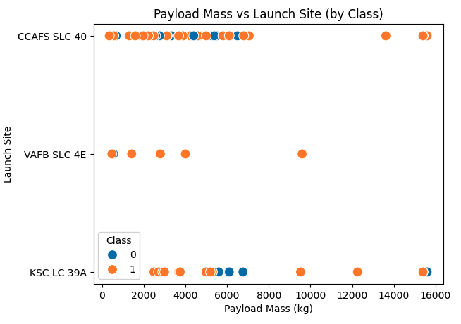
Payload vs. Launch Site
VAFB-SLC launchsite there are no rockets launched for heavy payload mass(greater than 10000).

Slide 19
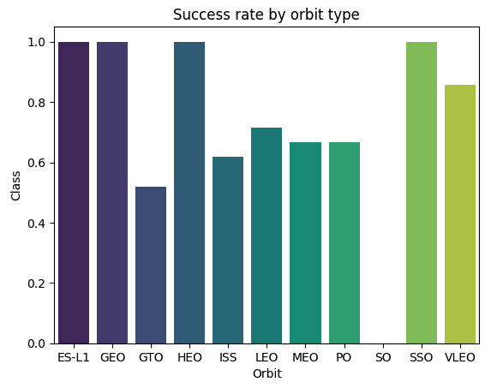
Success Rate vs. Orbit Type
We can clearly see orbit SO has zero success rate whereas, ES-L1, GEO, HEO, SSO has highest.

Slide 20
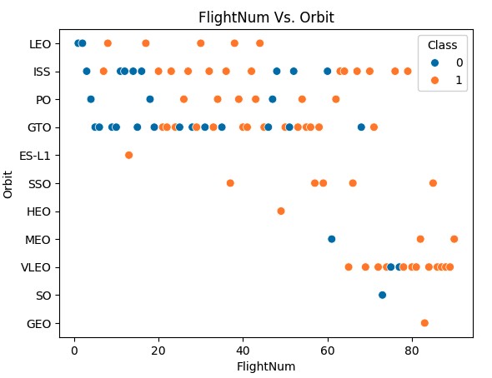
Flight Number vs. Orbit Type

Slide 21
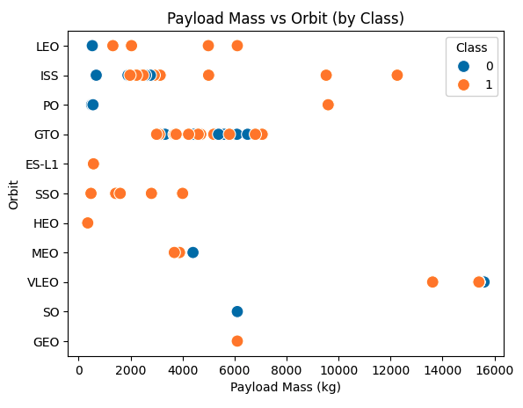
Payload vs. Orbit Type
Show a scatter point of payload vs. orbit type
Show the screenshot of the scatter plot with explanations

Slide 22
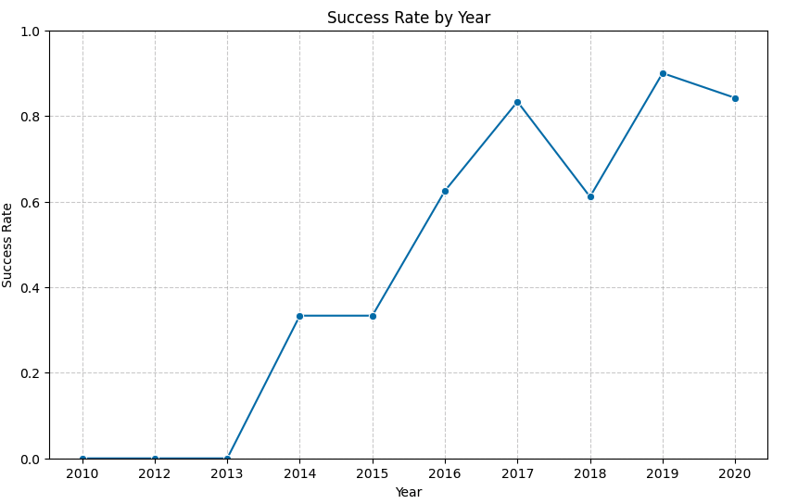
Launch Success Yearly Trend
Show a line chart of yearly average success rate
Show the screenshot of the scatter plot with explanations

Slide 23
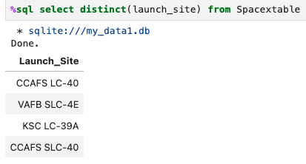
All Launch Site Names
Find the names of the unique launch sites

Slide 24
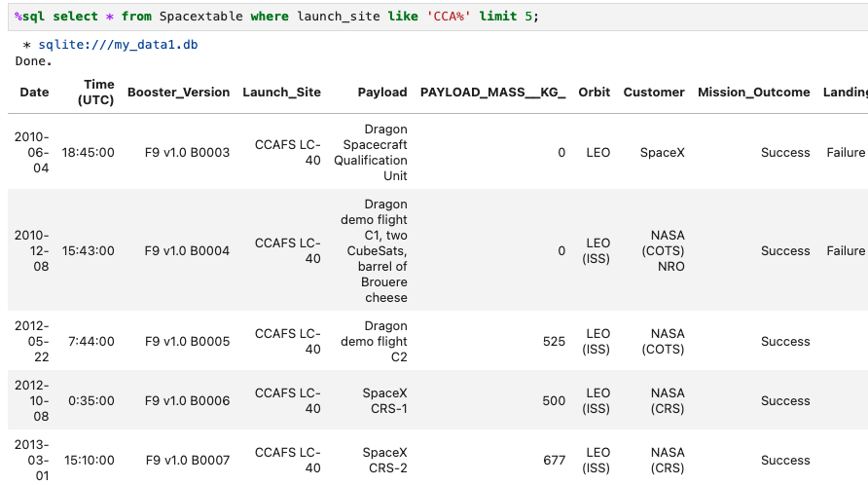
Launch Site Names Begin with 'CCA'
Find 5 records where launch sites begin with `CCA`

Slide 25
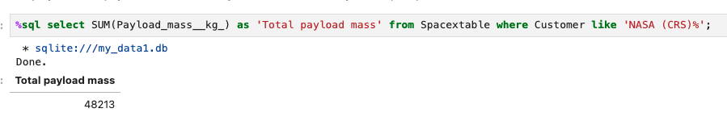
Total Payload Mass
Calculate the total payload carried by boosters from NASA

Slide 26
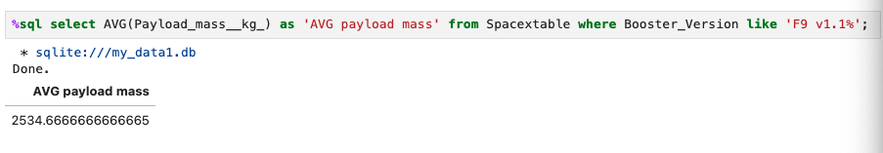
Average Payload Mass by F9 v1.1
Calculate the average payload mass carried by booster version F9 v1.1

Slide 27
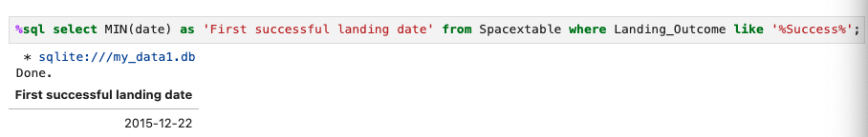
First Successful Ground Landing Date
Find the dates of the first successful landing outcome on ground pad

Slide 28
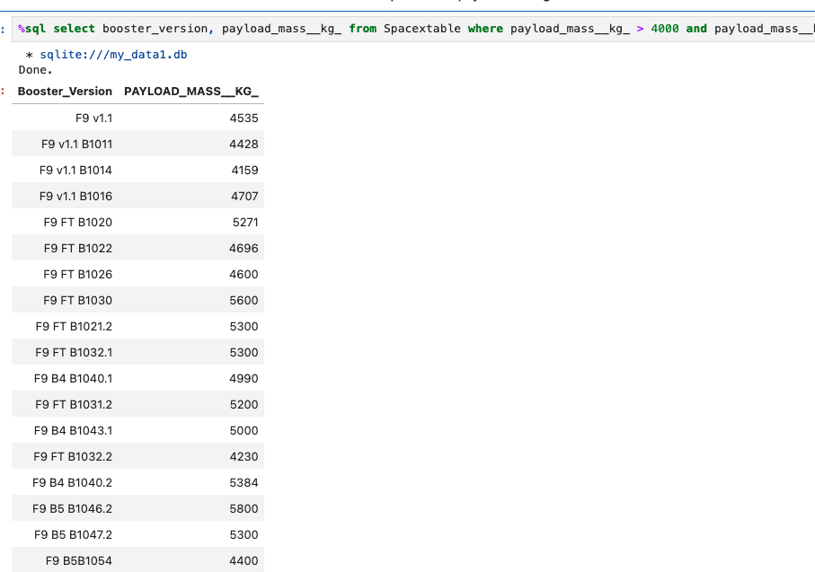
Successful Drone Ship Landing with Payload between 4000 and 6000
List the names of boosters which have successfully landed on drone ship and had payload mass greater than 4000 but less than 6000

Slide 29
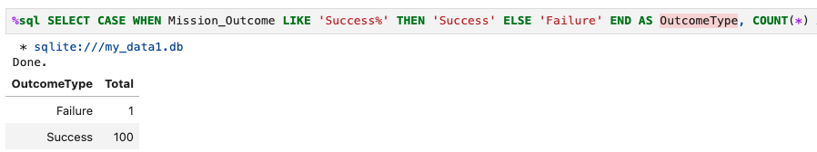
Total Number of Successful and Failure Mission Outcomes
Calculate the total number of successful and failure mission outcomes

Slide 30
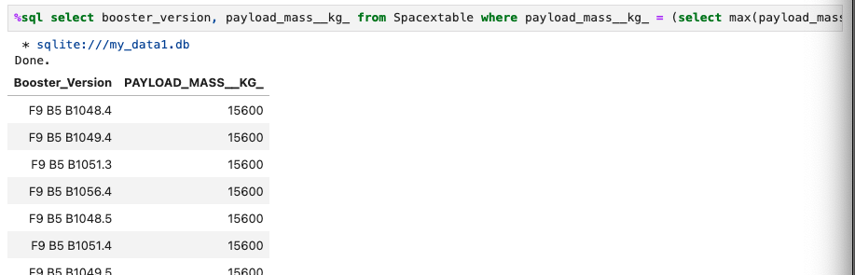
Boosters Carried Maximum Payload
List the names of the booster which have carried the maximum payload mass
Present your query result with a short explanation here

Slide 31
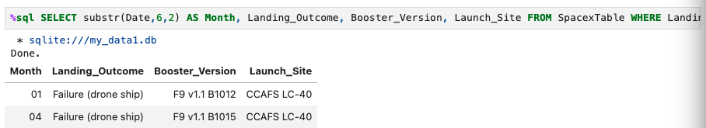
2015 Launch Records
List the failed landing_outcomes in drone ship, their booster versions, and launch site names for in year 2015
Present your query result with a short explanation here

Slide 32
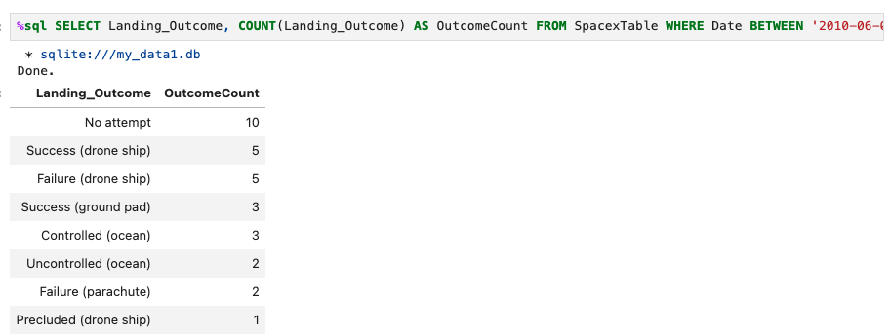
Rank Landing Outcomes Between 2010-06-04 and 2017-03-20
Rank the count of landing outcomes (such as Failure (drone ship) or Success (ground pad)) between the date 2010-06-04 and 2017-03-20, in descending order
Present your query result with a short explanation here

Slide 33

Section 3

Slide 34
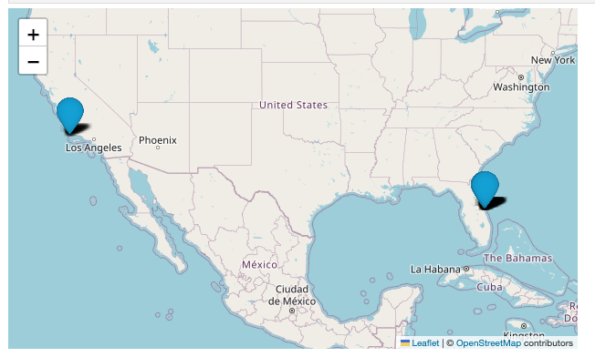
Map - all launch sites
Replace <Folium map screenshot 1> title with an appropriate title
Explore the generated folium map and make a proper screenshot to include all launch sites’ location markers on a global map
Explain the important elements and findings on the screenshot

Slide 35
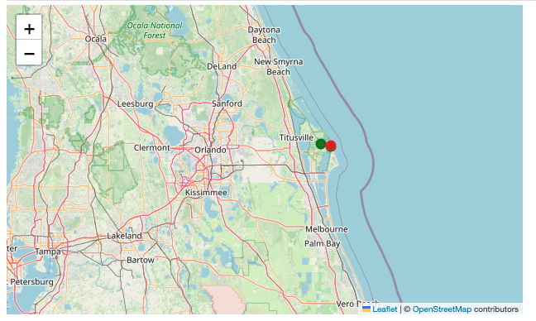
Map – green for success launch, red for else.
Replace <Folium map screenshot 2> title with an appropriate title
Explore the folium map and make a proper screenshot to show the color-labeled launch outcomes on the map
Explain the important elements and findings on the screenshot

Slide 36
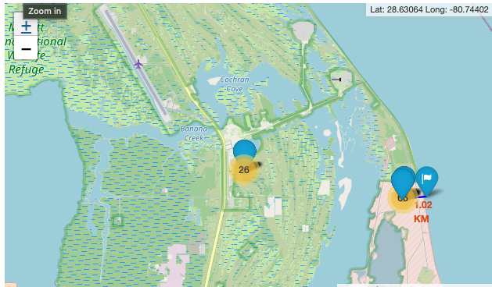
Map 3
Replace <Folium map screenshot 3> title with an appropriate title
Explore the generated folium map and show the screenshot of a selected launch site to its proximities such as railway, highway, coastline, with distance calculated and displayed
Explain the important elements and findings on the screenshot

Slide 37

Section 4

Slide 38
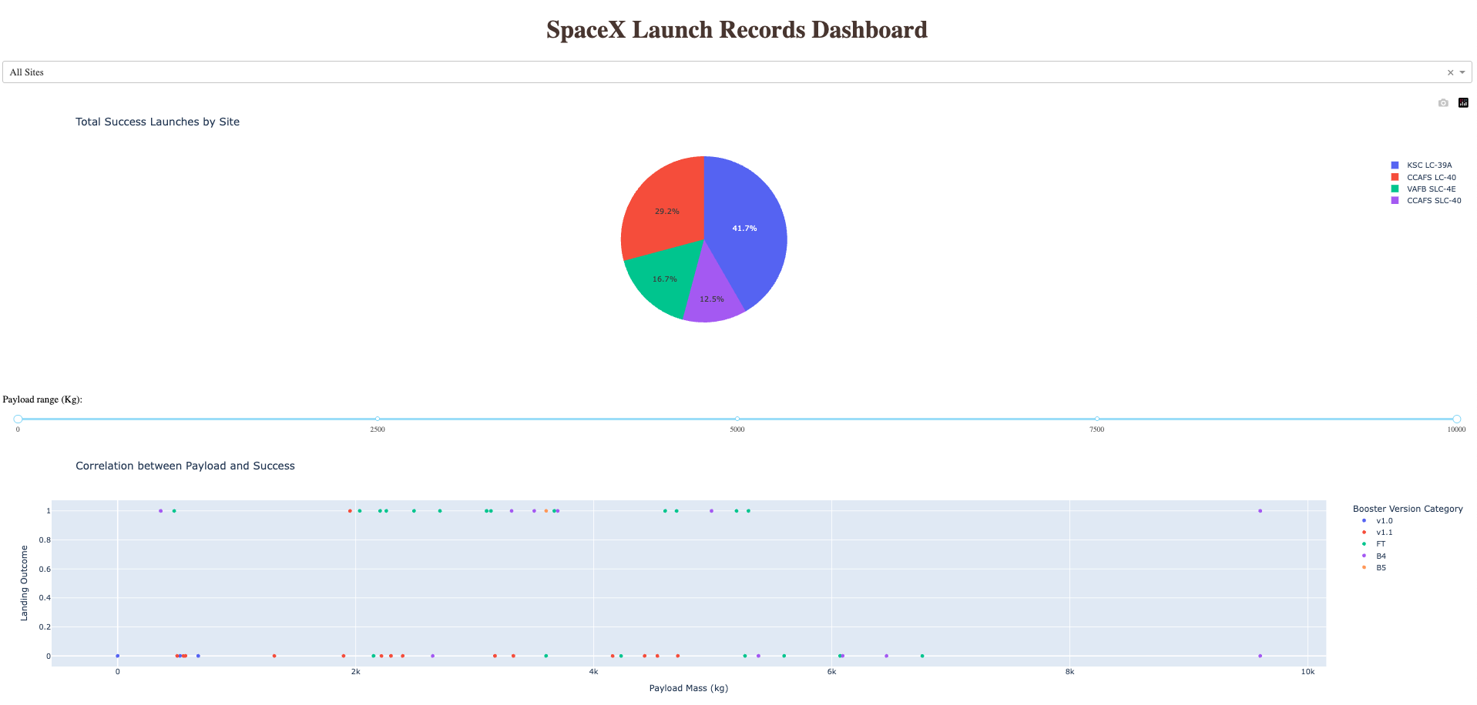
Dashboard - Total success launces by site

Slide 39
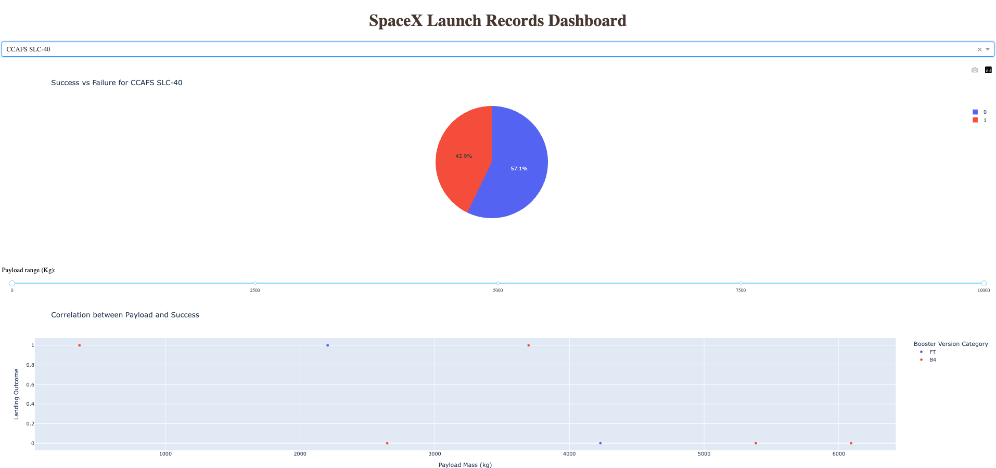
CCAFS SLC-40 site has highest success launch rate

Slide 40
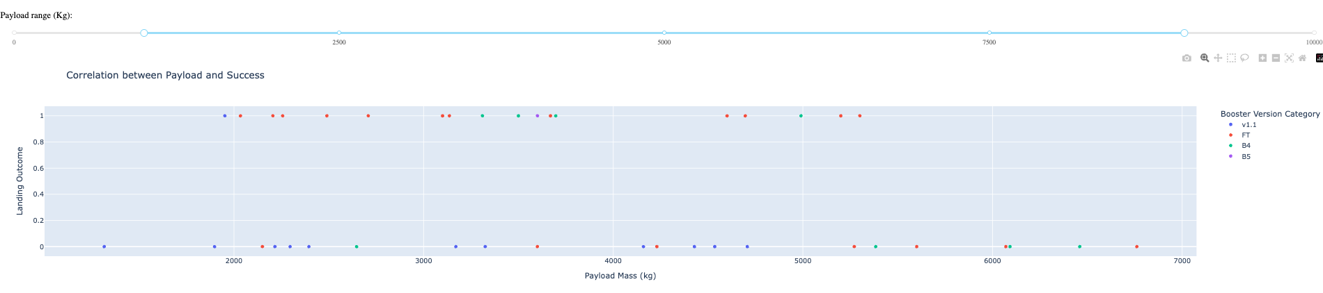
Payload range vs. landing outcome

Slide 41

Section 5

Slide 42
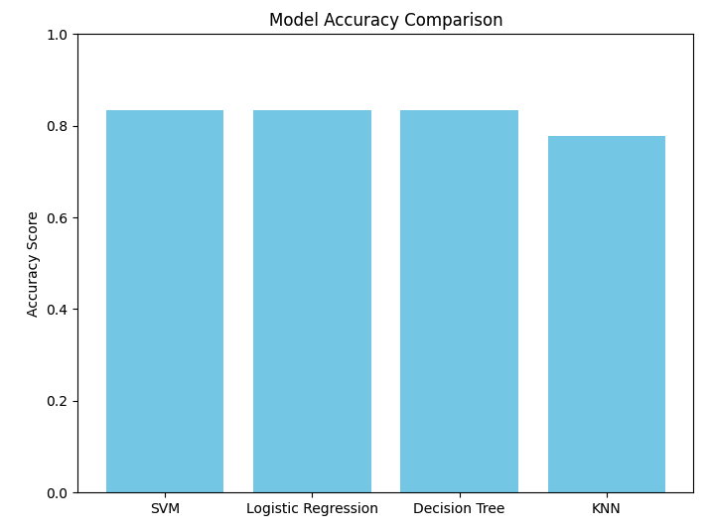
Classification Accuracy
SVM, LR and DecisionTree have same accuracy score of 83%, whereas KNN is 78%
Since all three best performed models have same accuracy, LogisticRegression would be best suited for our prediction
For the reason as it’s simple, interpretable (coefficients show how features affect probability), computationally efficient.

Slide 43
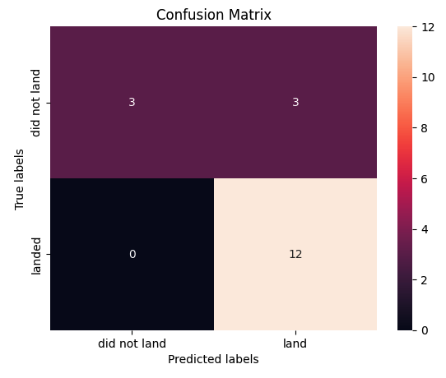
Confusion Matrix of LogisticRegression

Slide 44
Appendix
Include any relevant assets like Python code snippets, SQL queries, charts, Notebook outputs, or data sets that you may have created during this project

Slide 45


